Slide 1
Stadium Pollution
By Jeffrey, Alex, Justin,
And Connor

Slide 2
Stadium Attendance
Over 170 million people attend professional sporting events in the United States annually
48 million attend college games every year

Slide 3
POLLUTION STADIUMS CREATE
The average NFL game has about 60,000 people attend and about 20,000 cars
With the amount of cars at sporting events there is a lot of smog
The parking lots alone can create spikes in ozone pollution through smog

Slide 4
Amount of trash in stadiums
Each year sports stadiums generate about 39 million pounds of trash per year
Safeco Field generates around 7% of this total alone

Slide 5
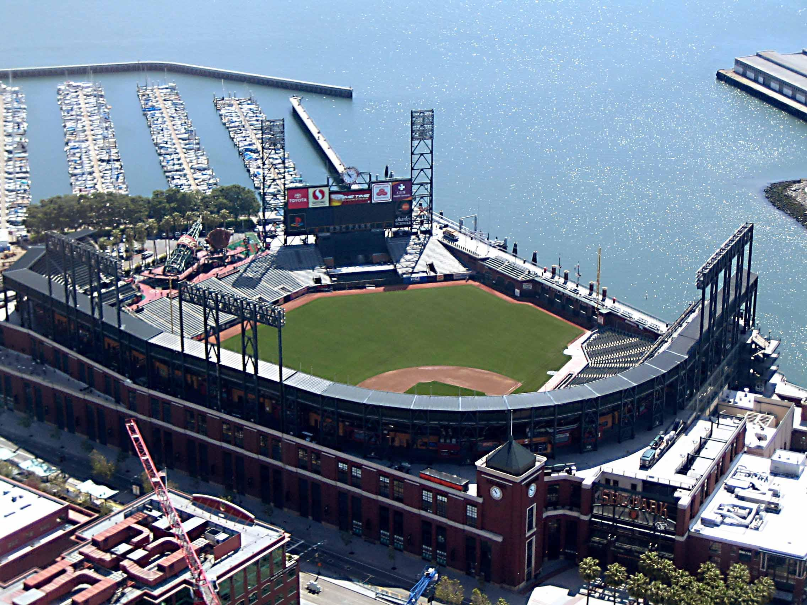
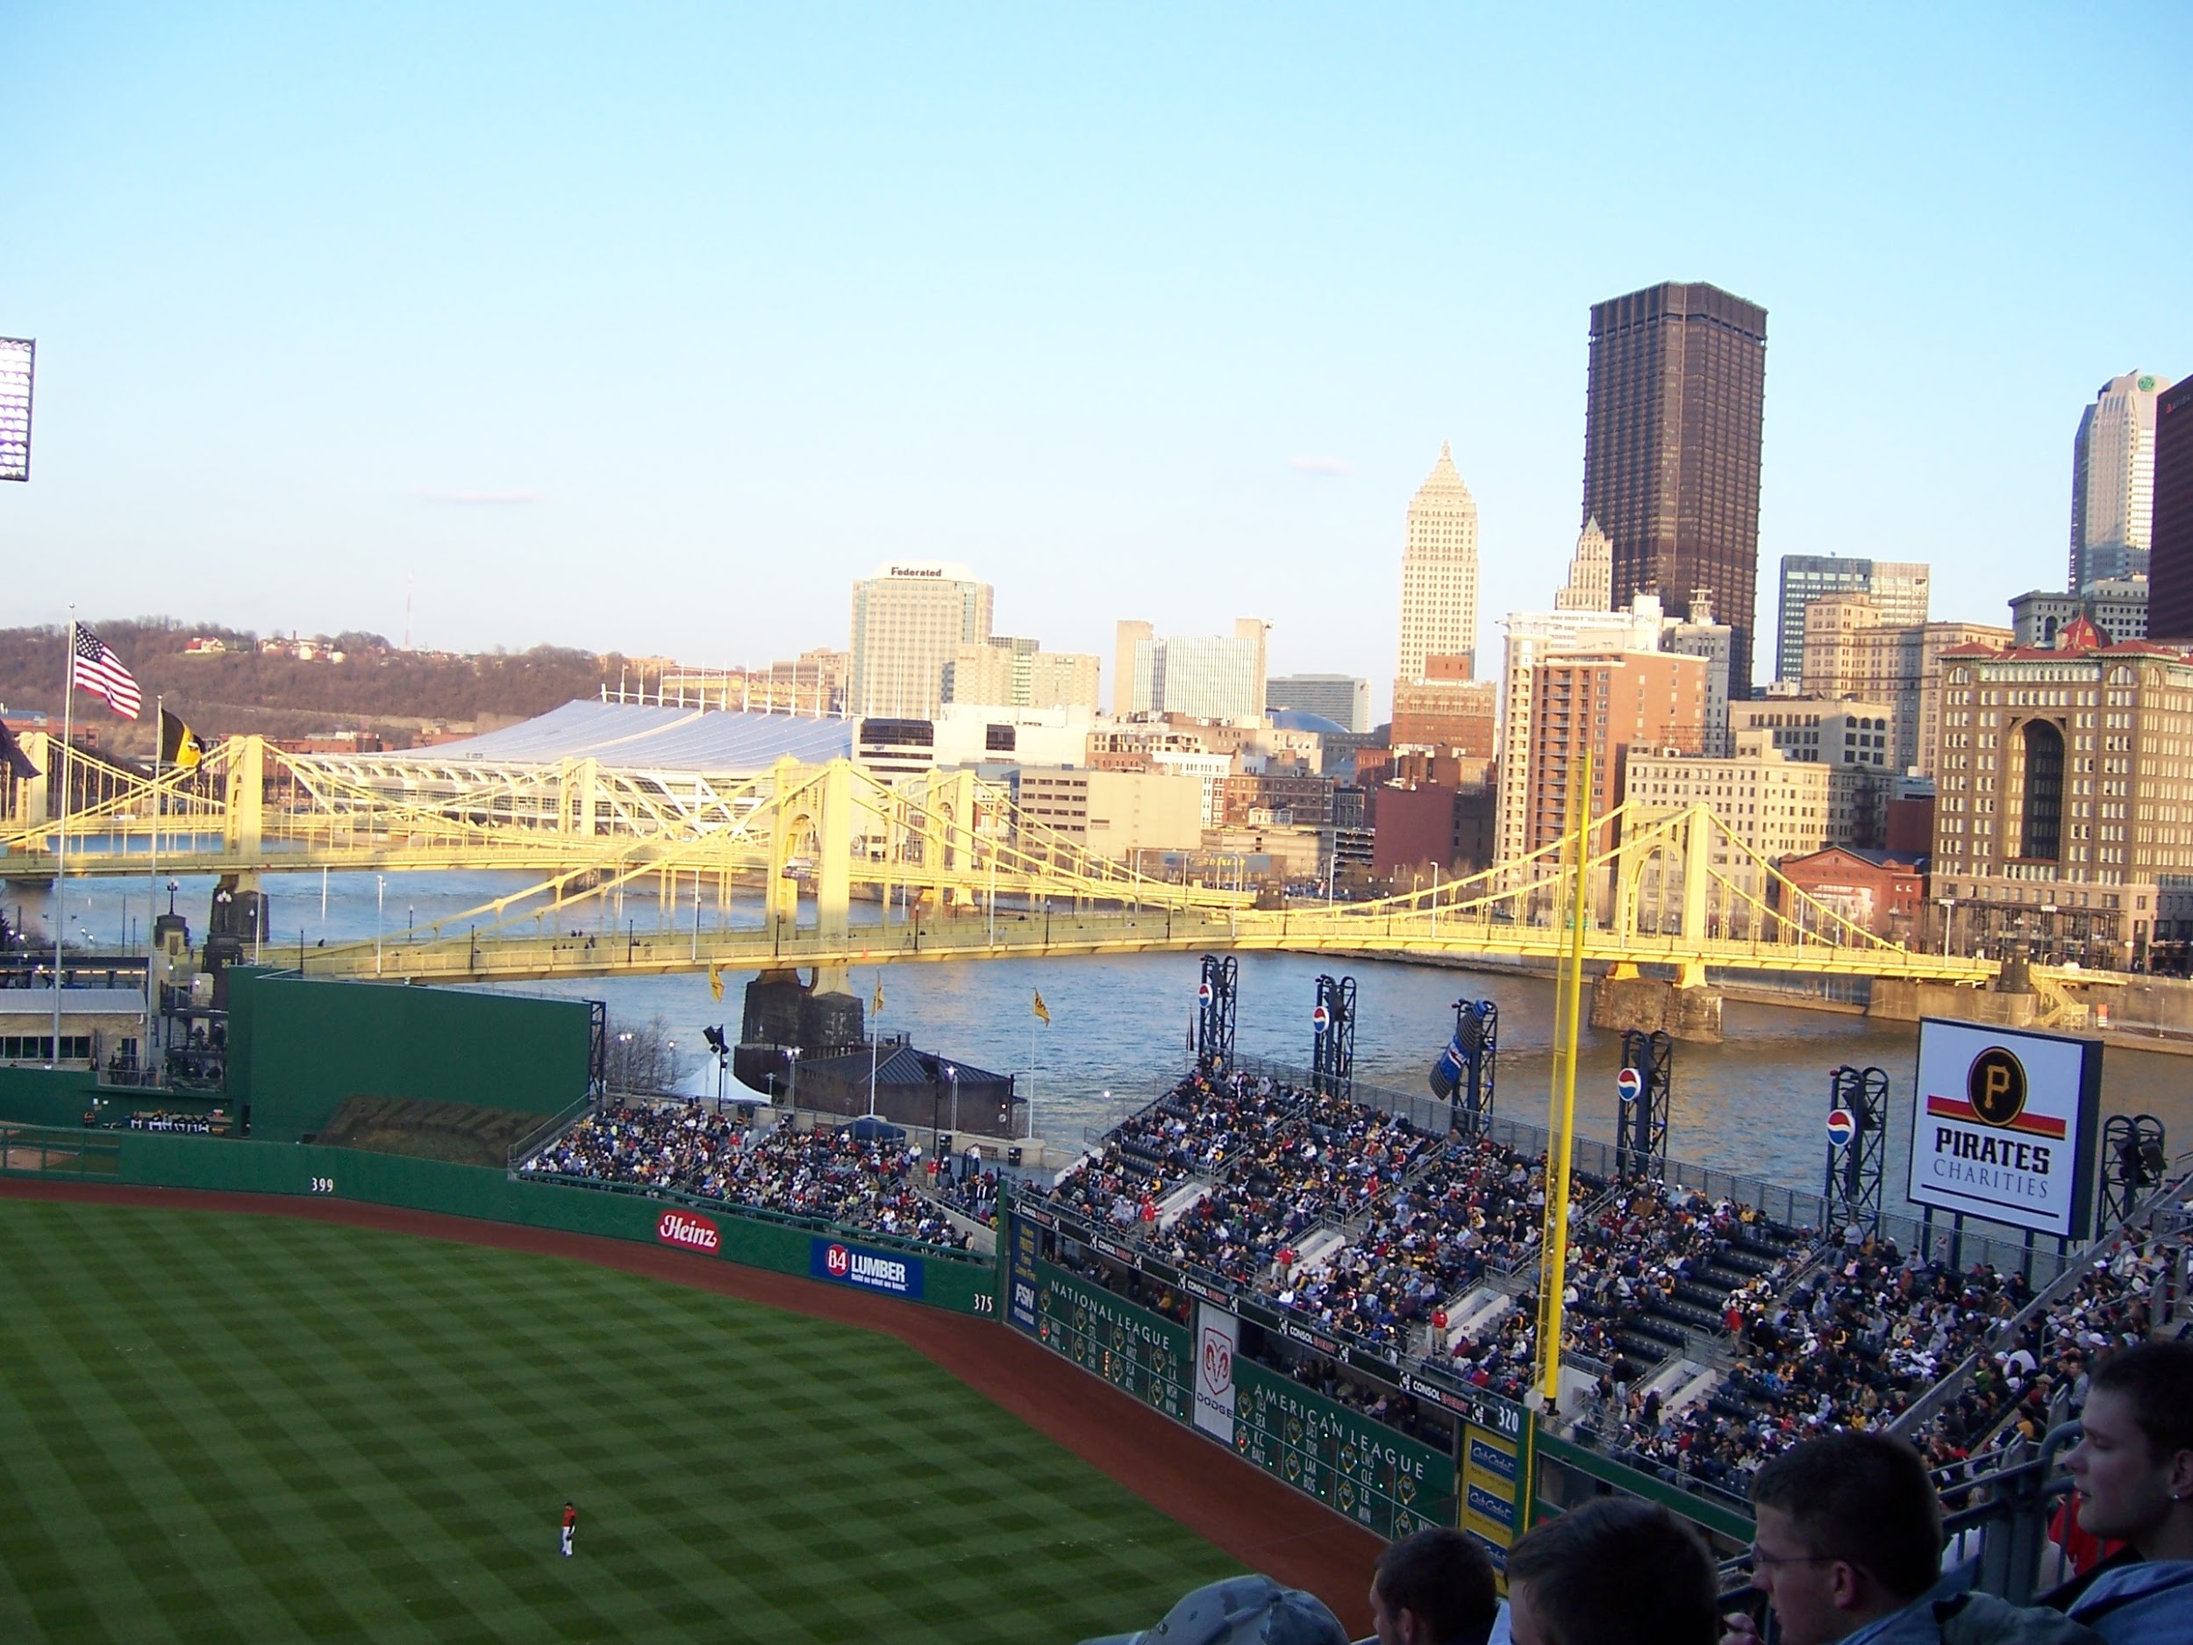
What does this create?
A huge buildup in trash can cause man problems
Many stadiums are near wildlife locations
At&t park and Safeco park are both located on bays

Slide 6
Why we need to take action
Animal habitats are being destroyed
We are causing harm to the earth

Slide 7
Our solution
Step 1: biodegradeble plastic bags on the backs of every seat
Step 2: Bio plastic containers/food trays
Step 3: this trash will go to a facility to be broken down
Step 4: this facility will be in the place of part of parking lots
These containers and bags contain Polylactide acid(PLA)

Slide 8
What is biodegradation?
Process by which organic substances are decomposed by microorganisms into simpler substances such as carbon dioxide, water and ammonia
Microorganisms involved are mainly aerobic bacteria, hydrocarbons, polychlorinated biphenyls, polyaromatic hydrocarbons, radionuclides and metals
Biodegradation is made up into 4 phases

Slide 9
Phases of Biodegradation
Aerobic Phase: the plastics being to break down from hydrolysis
Anaerobic Phase: monomers are converted to fatty acids
Acetogenisis Phase: fatty acids turned into acetic acid co2 and hydrogen
Methenogenic phase: acetic acid is turned into methane and co2. Hydrogen is consumed.

Slide 10
Why are normal plastics bad?
Normal plastic production and decomposition releases harmful toxins
Plastic water bottles take 3 times the amount of water to manufacture than it does to fill it
Plastics take up 25% of dumps

Slide 11
How biodegradable plastics are good
Biodegradable plastics are made of renewable materials
When they are created and decomposed they don’t release toxins
They are easier to produce and require less energy
By switching to biodegradable plastics we would be using less natural resources
They are much cheaper

Slide 12
What will this solve?
It will decrease the excess trash that sits around and that leaves the stadium
It will also decrease the buildup in smog created by the many cars
It will push more towards public transportation and carpools
It will decrease the amount of trash going to landfills

